Slide 1



From Legacy MVC to Modern MVC An ASP.NET Core Migration Path
@Scott_Addie

Slide 2
Agenda
Upgrade Paths
Assembly Portability
Dependency Injection
Tag Helpers / View Components
Package Management
Bundling & Minification

Slide 3


You Are Here
ASP.NET 4.6
.NET Framework 4.6
Operating Systems
Editors VS 2015
Web Server IIS

Slide 4


Determine Your Upgrade Path
ASP.NET Core 1.0
.NET Framework 4.6.2
* Debugging not currently supported
.NET Core 1.0
net462
netcoreapp1.0
Operating Systems
Operating Systems
Editors VS 2015, VS Code*
Editors VS 2015 , VS Code VS Code
Web Server IIS, Kestrel
Web Server IIS, Kestrel Apache, Kestrel

Slide 5
The Value Proposition of .NET Core
X-plat
Open source
Everything is a dependency (cafeteria plan)
Broader container support
Cloud-optimized
Notes:
ASP.NET introduced in 2002

Slide 6
Assembly Portability

Slide 7
Assembly Portability
.NET Portability Analyzer
I Can Has .NET Core

Slide 8
Dependency Injection

Slide 9
Native IoC Container Construction Injection
Startup.cs
public void ConfigureServices(IServiceCollection services) { services.AddTransient<IAttendeeService, AttendeeService>(); // Add framework services. services.AddMvc(); }
AttendeesController.cs
public class AttendeesController : Controller { IAttendeeService _attendeeService; public AttendeesController(IAttendeeService attendeeService) { _attendeeService = attendeeService; }

Slide 10
Autofac Constructor Injection
DefaultModule.cs
public class DefaultModule : Module { protected override void Load(ContainerBuilder builder) { builder.RegisterType<AttendeeService>().As<IAttendeeService>(); } }
Startup.cs
public IServiceProvider ConfigureServices(IServiceCollection services) { // Add framework services. services.AddMvc(); var containerBuilder = new ContainerBuilder(); containerBuilder.RegisterModule<DefaultModule>(); containerBuilder.Populate(services); var container = containerBuilder.Build(); return container.Resolve<IServiceProvider>(); }
AttendeesController.cs
public class AttendeesController : Controller { IAttendeeService _attendeeService; public AttendeesController(IAttendeeService attendeeService) { _attendeeService = attendeeService; }

Slide 11
3rd Party DI Frameworks
More feature rich
Extensible lifetimes (per thread, per resolve cycle, etc.)
Auto wiring of types in assembly
Resolve Lazy<T> instances of registered types
Recommendation:
Native IoC for greenfield development
3rd party IoC to migrate existing investment

Slide 12
Tag Helpers / View Components

Slide 13
Package Management

Slide 14
NuGet Changes
packages.config is dead
VS 2015 Update 1+ for project.json support
project.json as a NuGet-only artifact
OLD ➔ .sln_folder\packages
NEW ➔ %USERPROFILE%\.nuget\packages

Slide 15
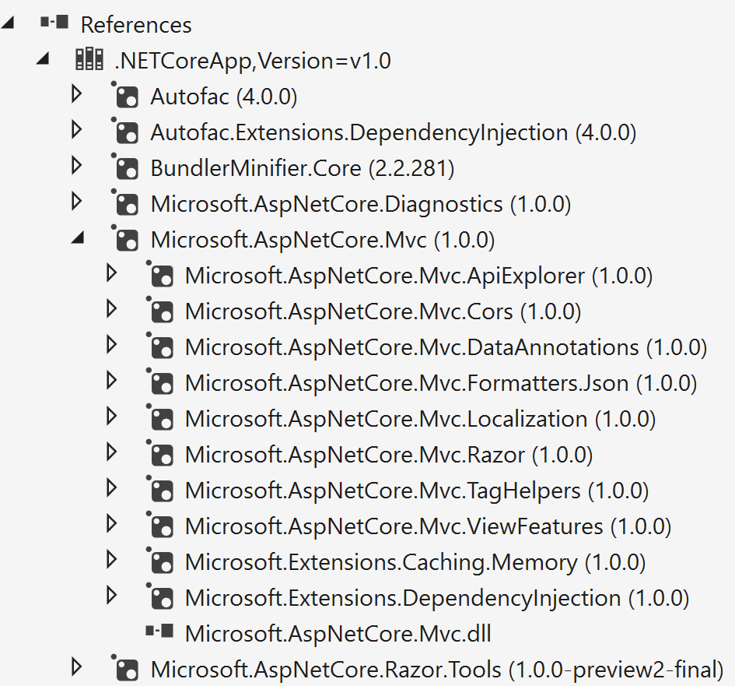
NuGet Transitive References
project.json
{ "dependencies": { "Microsoft.NETCore.App": { "version": "1.0.0", "type": "platform" }, "Microsoft.AspNetCore.Diagnostics": "1.0.0", "Microsoft.AspNetCore.Mvc": "1.0.0", "Microsoft.AspNetCore.Razor.Tools": { "version": "1.0.0-preview2-final", "type": "build" },

Slide 16
NuGet Centralized Packages Repository

Slide 17


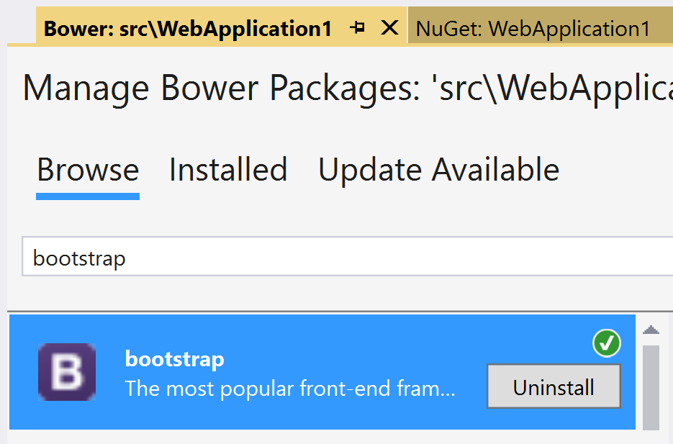
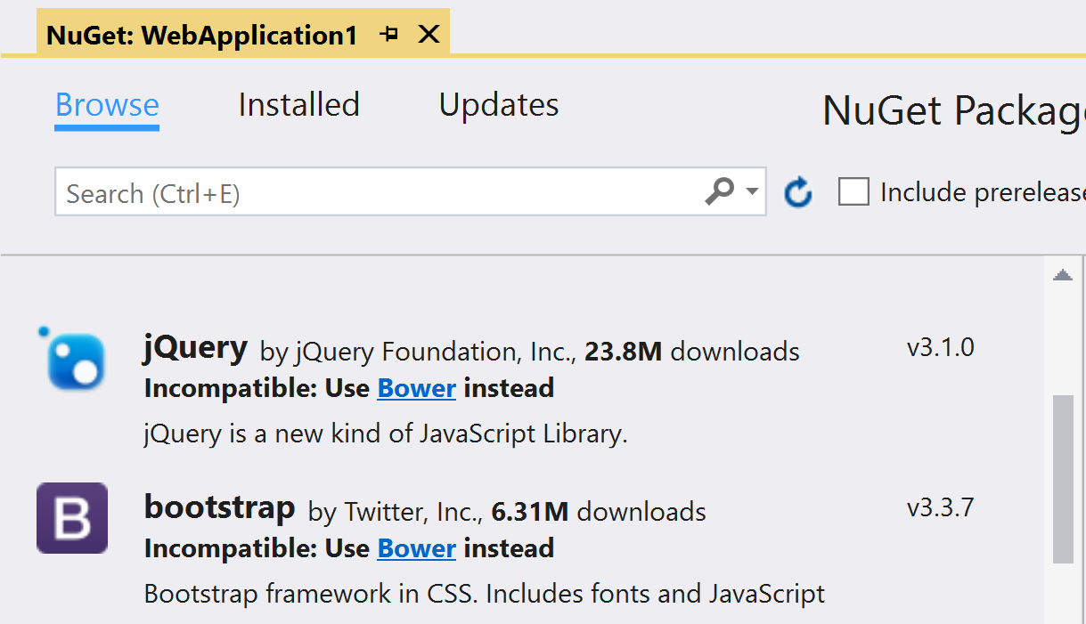
Bower Static Asset Acquisition
Manage NuGet Packages
Manage Bower Packages
Notes:
- Content files not supported in ASP.NET Core projects

Slide 18
Bundling & Minification

Slide 19
A Look at Where We’ve Been
Microsoft.AspNet.Web.Optimization
Grunt
Gulp
ASP.NET 4.5
NuGet
C# or VB.NET
On-the-fly processing by web server
ASP.NET 5 Beta
npm
JavaScript
Process before deploying
ASP.NET Core 1.0 RC
npm
JavaScript
Process before deploying

Slide 20

The Way Forward
bundleconfig.json
BundlerMinifier.Core
[ { "outputFileName": "wwwroot/css/site.min.css", "inputFiles": [ "wwwroot/css/site.css" ] }, { "outputFileName": "wwwroot/js/site.min.js", "inputFiles": [ "wwwroot/js/site.js" ], "minify": { "enabled": true, "renameLocals": true }, "sourceMap": false } ] } ]
ASP.NET Core 1.0 RTM
NuGet
JSON
Process before deploying

Slide 21
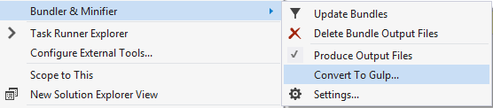
…but Gulp still has its place
Bundler & Minifier extension
Reserve for complex workflows

Slide 22
Resources
Migrating from ASP.NET MVC to ASP.NET Core MVC
Using DI in ASP.NET Core
Project.json all the things

